Slide 1
Validation, Verification and Uncertainty of Measurement
Graham Fews
West Midlands Regional Genetics Laboratory

Slide 2
Things are what they are, and whatever will be will be.
Jonas Jonsson- The Hundred-Year-Old Man Who Climbed Out of the Window and Disappeared.

Slide 3
What is the difference between validation and verification?
Is the test correct.
Are we testing correctly.

Slide 4
When do you validate? When do you verify?
When it is an in-house test or significant change to a procedure.
When it is a commercial kit or extension of current protocol.

Slide 5
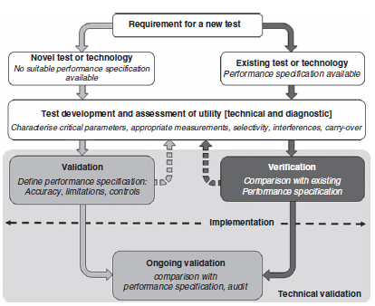
Mattocks CJ et al EJHG (2010) 18: 1276-1288

Slide 6
Validation
3.26
Confirmation, through the provision of objective evidence, that the requirements for a specific intended use or application have been fulfilled
Adapted from ISO 9000:2005 definition 3.8.5

Slide 7
Verification
3.27
Confirmation, through provision of objective evidence, that specified requirements have been fulfilled.
Confirmation can comprise activities such as:
Performing alternative calculations
Comparing a new design specification with a similar proven design specification
Undertaking tests and demonstrations
Reviewing documents prior to use

Slide 8
Looking at the accuracy of the procedure.
There must be documented objective evidence to support validation and verification.
This may be cited references or protocols for historic tests.

Slide 9
Performance characteristics must be determined for the sample types for which accreditation is being sought.
Define clear specification of procedure/equipment performance requirements.
UKAS does not prescribe the number of samples required during the process; but requires the process to be sufficient in its extent.

Slide 10
What is Uncertainty of Measurement?

Slide 11
If any measurement is made independently by a large number of analysts, their results will differ through a range of values

Slide 12
What measurable conditions/activities affect your testing?
Strictest definition is for quantitative testing.
However it is applicable to qualitative testing.
‘Not applicable’ is not an option.
Must consider where applicable in your processes.

Slide 13
Uncertainty of Measurement
Some tests are qualitative in nature, i.e., they do not yield a numeric result. Therefore there can be no meaning in reporting uncertainties directly associated with the test result. Nevertheless, there will be uncertainties associated with the underlying test conditions and these should be subject to the same type of evaluation as is required for quantitative test results.
M3003 The Expression of Uncertainty and Confidence in Measurement Ed 3 Nov 2012 UKAS

Slide 14
Examples
The process of G-banding uses trypsin, the activity of which is effected by temperature. How do you control the impact?
The performance of pipettes is effected by the viscosity of the liquid. How do you control the impact?

Slide 15
Think Troubleshooting
We all do Measurement of Uncertainty; we just don’t recognise it or necessarily document it.
If you consider the ‘what could cause a problem’ you will probably identify any possible uncertainty of measurement.
Uncertainty of measurement is the cause of uncertainty of result.

Slide 16
The result of a test is what you get when you apply a defined test method from a given set of start conditions.
If you change the test method, or deviate from the start conditions, you don’t get the wrong answer to the right test.
You get the right answer to the wrong test.

