Slide 1
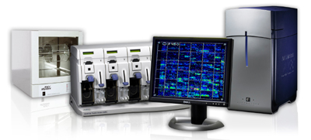
Affymetrix MDS Cytoscan HD Project
Laura Ford
Genetic Technologist
WMRGL

Slide 2
Introduction
What is MDS
Why Microarrays in MDS
Project Overview
Overview of Cytoscan Assay
Project Progress

Slide 3
Myelodysplastic syndrome (MDS)
MDS patients comprise largest diagnostic group of Oncology samples received in WMRGL ~900 samples a year.
Characterised by production of abnormal myeloid cells (normal maturation and development but dysplastic)
Clinically result in cytopaenias (reduction in cells)
Pancytopaenia
Neutropaenia
Thrombocytopaenia
Blasts may be present (<20%)
Risk of progression to AML in 20~40%

Slide 4
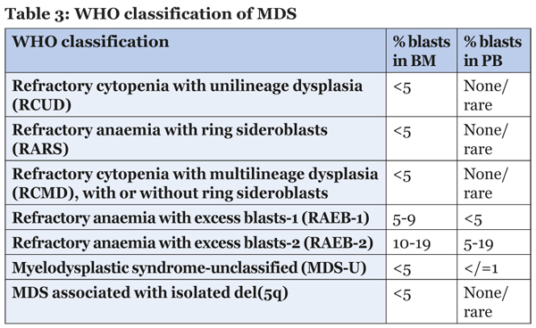
Myelodysplastic syndrome (MDS)
WHO (World Health Organisation)

Slide 5
Project Overview
Funded by Affymetrix –
600 SNP-arrays over 2 years at diagnosis and follow up of MDS/?MDS patient
Equipment-
Affymetrix Genechip Fluidics station
Affymetrix Genechip Hybridisation oven
Affymetrix Genechip Scanner
Affymetric CHAS software (Chromosome analysis software)
Aim to Demonstrate clinical utility of Affymetrix Cytoscan HD array
Notes:
G-banding is time consuming and a normal karyotype in 50% of cases - In my experience G-band analysis is only abnormal in 10% of cases, looked back at my last 100 MDS cases only 10 abnormal?
Celegene- in order for prognostic scoring to identify patients who will benefit from modern treatments, including Azacytidine
We do also offer as charged service if clinician requests SNP array not part of the project

Slide 6
Project Overview
And Funded by Celgene –
Analysis of MDS cases to improve G-band MDS turn around times
Target ~ 21 days (14 days)
Improve Turn around times and prognostic scoring to identify patients who will benefit from modern treatments, including Azacytidine
Notes:
G-banding is time consuming and a normal karyotype in 50% of cases - In my experience G-band analysis is only abnormal in 10% of cases, looked back at my last 100 MDS cases only 10 abnormal?
Celegene- in order for prognostic scoring to identify patients who will benefit from modern treatments, including Azacytidine
We do also offer as charged service if clinician requests SNP array not part of the project

Slide 7
Project Overview
SNP Array is Complementary to G-band analysis
Clinicians not charged for SNP Array testing
providing the patients are confirmed MDS cases and correct consent is received for access to patient clinical history
Also Run non project samples requested by clinicians as a charged service
Notes:
G-banding is time consuming and a normal karyotype in 50% of cases - In my experience G-band analysis is only abnormal in 10% of cases, looked back at my last 100 MDS cases only 10 abnormal?
Celegene- in order for prognostic scoring to identify patients who will benefit from modern treatments, including Azacytidine
We do also offer as charged service if clinician requests SNP array not part of the project

Slide 8
Use of SNPs
Allows Characterization of LOH, UPD and consanguinity
SNP Genotyping allows allele-specific copy number analysis
Can use for Independent confirmation of copy number changes with SNP allelic information
Enhanced ability to measure mosaicism and assess array/sample quality

Slide 9
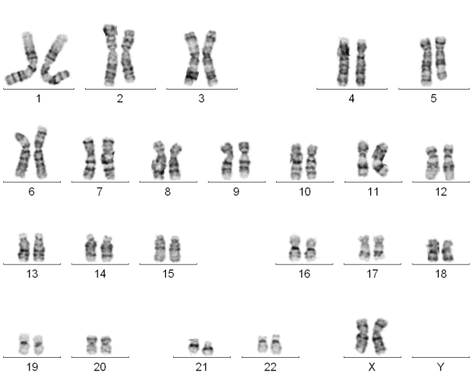
Why Microarray in MDS?
Cytogenetic changes in MDS are largely copy number
Arrays offer multiplex CN analysis in a single test
duplications, amplifications, deletions
can detect copy neutral loss of heterozygosity (CN-LOH)
Increase resolution beyond G-band chromosome
Potential to use Peripheral Blood instead of Bone Marrow
Could replace chromosome analysis as front line tool for MDS testing

Slide 10
Project Roles
50% of time G-band chromosome analysis of MDS/?MDS cases (for celgene)
Improve turnaround times <21 days
50% of time Set up Affymetrix Cytoscan HD Array
Competent on lab protocol
Hope to prove its utility and roll out its use in front line tool for diagnosis of MDS patient
Patient Selection
Secure patient consent (research nurses/consultants)
Data entry patient follow up (confirmed MDS)
Secure follow up info when not received
Update KPI’s (monthly data for Affy and Celgene)
FISH training- confirm/Exclude SNP Array Results
Not carrying out yet

Slide 11
Patient Selection
DNA extracted- Qiamp
?MDS/MDS routinely DNA extracted
Quality assessed –
minimum concentration 50ng/µL
260/280 ratio 1.8>2
260/230 ratio 1.5>2.3
Follow up and Consent received
Patients need to be confirmed MDS
Consent required for project (access patient records)

Slide 12
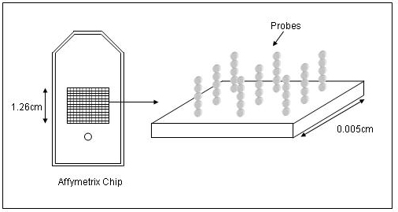
Cytoscan HD Platform
High Density Gene level coverage
Covers >36000 Ref Seq Genes
High Density SNP and CN probe coverage for whole genome coverage
2.6 million markers including
750,000 SNP’s
1.9 million non-polymorphic probes
Enriched Gene coverage for cancer markers

Slide 13
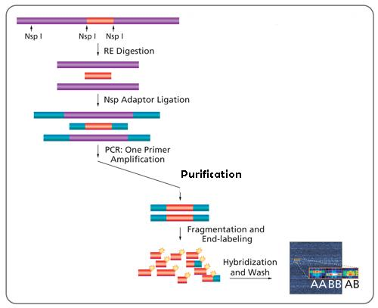
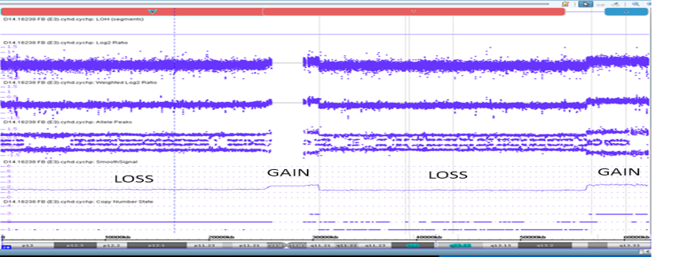
Overview of CytoScan™ Assay
Notes:
Digestion- restriction enzyme NSP1 used to digest DNA into fragments
Ligation- uses small DNA nsp1 adaptors (linkers) ligated to the DNA to be amplified and then multiple primers annealing to the DNA adaptors using a T4 DNA Ligase to replicate whole genome.
PCR – is then used to amplify DNA.
Purification – using magnetic beads that attach to DNA and then washing with wash buffer
Fragmentation – fragmenting the DNA into shorter pieces so it will hybridize to the Array
Labelling – with a chemical that acts as a molecular glue for flourescent molecules (stain) that will be washed over chip.
Hybridize to Array Chip – 16- 18 hours over night.
Stained and wash off anything that hasn’t Hybridized.
Scanned over night

Slide 14
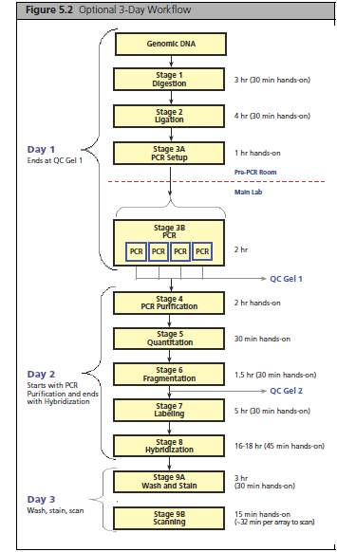
Workflow in Lab
Arial regular for the body copy…
Day 1 → Prep for the week run (AM)
Bleach FS
2. Worksheets
3. Dilutions
4. Make 2% and 4% Gels x2
Day 2 →
1. Run PCR gel QC check
2. Nano Drop QC after Purification
3. Frag Gel QC after fragmentation
Day 3→
Prepare wash/Stains
Prepare Chips only after frag gel passed
Upload Batch Registration Files
5. Chip loading → Loading check.
Day 3.5 →
CEL files uploaded to be processed
CEL files uploaded to CHAS
2 x Samples spreadsheets to be updated with QC results and Lot numbers.
Notes:
16 samples 3.5 day protocol with day 2 being 8.30am to 6pm (Affy markets it at 2.5 day protocol).

Slide 15
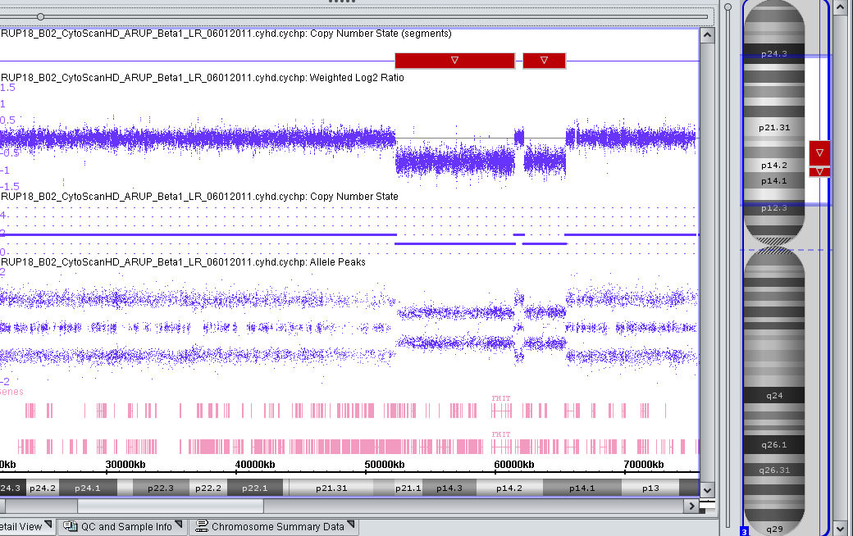
Example: Loss on Cytoscan
Arial regular for the body copy…
Notes:
Example of the end result on CHAS. Scanned signal pattern generates log ratio.

Slide 16
What have we done so far?
84 samples run on SNP array
43 analysed
34 reported and results issued
24 normal results found, 10 abnormal
9 cases are undergoing further investigation
Cases that failed G-banding
4 cases normal by SNP array
2 cases abnormal by SNP array

Slide 17
Summary Results Table
Case number | Karyotype | SNP array | Karyotype and SNP match?
1 | normal | normal | yes
2 | normal | normal | yes
3 | normal | normal | yes
4 | normal | normal | yes
5 | normal | normal | yes
6 | normal | normal | yes
7 | normal | normal | yes
8 | normal | normal | yes
9 | normal | normal | yes
10 | normal | normal | yes
11 | fail | normal | no
12 | fail | normal | no
13 | fail | normal | no
14 | fail | normal | no
15 | fail | +12 | no
16 | fail | Idic der(20q) | no
17 | del(5q) | del(5q) | yes
18 | +8 | +8 | yes
19 | del(5q) | del(5q) | yes
20 | Abnormal 46,XX,del(5)(q1q3)[5]/ 46,XX,del(5)(q1q3),del(11)(q23)[2]/ 45,XX,del(5)(q1q3),der(7;11)(q10;q10)del(11)(q23)[2]/ 46,XX[1] | Abnormal arr 5q14.3q33.3(72,739,251-83,696,150)x1,7pterp11.2 (1-57,601,477)x1,11p11.12q13.1(50,036,272-63,240,914)x1,11q13.1q13.1(64,501,919-65,446,765)x1,11q13.4q14.1(72,699,585-79,896,194)x3,11q14.1qter (84,666,715-134,942,625)x1 | no

Slide 18
Unanswered Questions?
Are the results from SNP comparable to G banding?
Is anything extra found or missed by using one technique over the other?
Can we use blood instead of marrow? Can we reduce Turn around Times?
Is it cost effective?
Could SNP arrays replace G-banding as front line tool for MDS testing?

Slide 19
Acknowledgements
Sally Jeffries – Project Lead
Emma Huxley – Project Manager
Nicola Trim – Project Researcher
Sue Rose and Jane Soden
Thank you
Extraction Hub
Array Hub

Slide 20
Any Questions?

